Slide 1


Slide 2
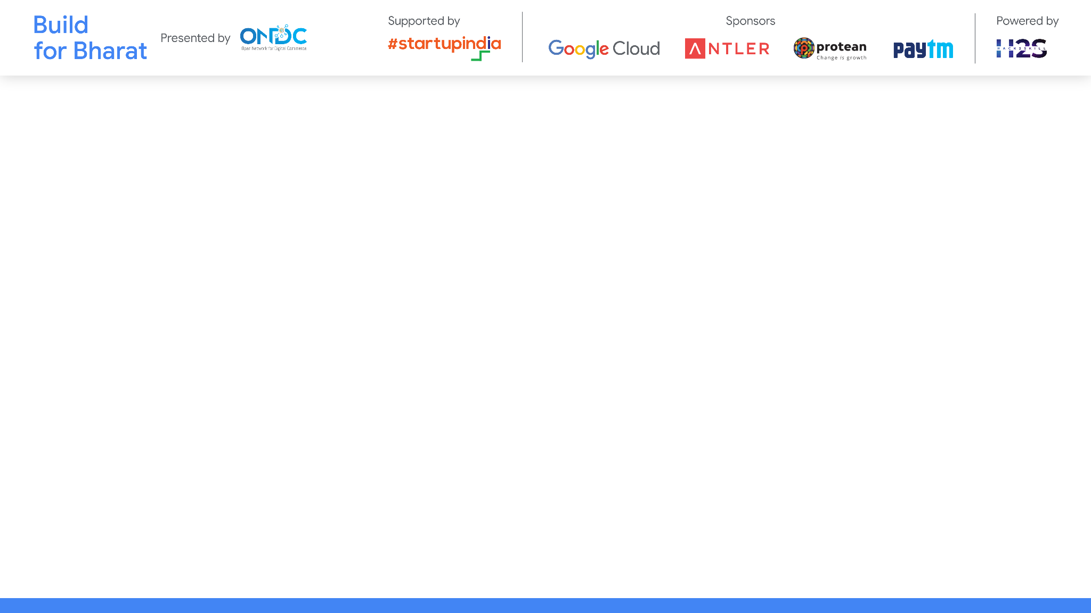
Team Name: DataDynamos
Team Leader Name: Ritesh Savale
Team Member Names: Vijaey Anand, Sahil Bhandari, Sakthi Eswaran
Problem Statement Category: Foundational or Scalable Solution
Problem Statement: Price optimization Engine

Slide 3
Architecture & Design for the innovative solution.
The proposed solution adopts a modular architecture that fosters flexible integration options, ensuring seamless scalability and extensibility to accommodate various use-cases. The architecture comprises several key components:
1. Data Acquisition and Preprocessing Module
2. Feature Engineering and Selection Module
3. Machine Learning Model Building Module
4. Evaluation and Validation Module
5. Deployment and Monitoring Module

Slide 4
Architecture & Design for the innovative solution.
Key Design Considerations:
Reusability: The solution emphasizes the reusability of APIs, algorithms, and datasets to facilitate easy integration and interoperability with existing systems.
Extensibility: The architecture is designed to be extensible, allowing for seamless integration of additional use-cases or features as the project evolves.
Scalability: The solution is engineered to operate efficiently at population scale, with the capability to handle large volumes of data while maintaining optimal capacity and minimal latency.
Security: Transactional guarantees are ensured to maintain the confidentiality, integrity, and availability of sensitive data throughout the system.
Overall, the proposed architecture provides a robust and innovative solution for predicting price of Grocery costs, leveraging machine learning techniques and advanced data analytics to deliver actionable insights for informed decision-making
.

Slide 5
Customization Options:
Feature Selection and Engineering: Clients can customize the feature selection and engineering process based on their specific requirements and domain knowledge. This includes selecting relevant features, creating new features, and fine-tuning feature transformations to enhance model performance.
Algorithm Selection: The solution offers flexibility in algorithm selection, allowing clients to choose from a variety of machine learning algorithms based on their data characteristics and business objectives.
Hyperparameter Tuning: Clients can customize hyperparameter tuning parameters to optimize model performance further. This includes fine-tuning parameters such as tree depth, learning rate, and regularization strength to achieve the best possible results for their specific use-case.

Slide 6
Model Evaluation Metrics: Clients can customize the evaluation metrics used to assess model performance based on their business goals and objectives. This includes choosing appropriate metrics such as accuracy, precision, recall, or F1-score, depending on the specific requirements of the application.
Deployment Options:
Cloud Deployment: The solution can be deployed on cloud platforms such as Amazon Web Services (AWS), Microsoft Azure, or Google Cloud Platform (GCP). Cloud deployment offers scalability, flexibility, and cost-effectiveness, allowing clients to scale resources up or down based on demand.
On-Premises Deployment: For clients with strict data privacy or regulatory requirements, the solution can be deployed on-premises within their own infrastructure. This option provides greater control over data security and compliance while still leveraging the power of machine learning and analytics.

Slide 7
Containerization: The solution can be containerized using technologies such as Docker and Kubernetes, enabling seamless deployment across different environments and ensuring consistency and portability.
API Integration: The solution can be exposed as RESTful APIs, allowing for easy integration with existing systems, applications, and workflows. Clients can access predictive capabilities and insights from the solution through standardized API endpoints, enabling seamless integration into their business processes.
Continuous Integration/Continuous Deployment (CI/CD): A CI/CD pipeline can be established to automate the deployment process, ensuring rapid and reliable delivery of updates and enhancements to the solution. This enables agile development practices and facilitates iterative improvements based on feedback and evolving requirements.

Slide 8
Test cases & data (as applicable) against which the eval criteria can be assessed
Test Cases:
Data Preprocessing:
Test Case 1: Ensure all required datasets (aisles, departments, order products, orders, products) are successfully loaded.
Test Case 2: Check for missing values in the datasets and verify that appropriate handling mechanisms are in place (e.g., imputation or removal).
Test Case 3: Validate the consistency and completeness of the preprocessed data.
.

Slide 9
Feature Engineering:
Test Case 4: Verify that new features are created successfully and are relevant to the prediction task.
Test Case 5: Ensure feature transformations (e.g., scaling, encoding) are applied correctly and improve model performance.
Test Case 6: Validate the integrity of the feature engineering pipeline and confirm that it produces consistent results across different runs.
Model Building:
Test Case 7: Train multiple machine learning models using different algorithms (e.g., decision trees, nearest neighbors) and verify their performance.
Test Case 8: Evaluate model performance using appropriate metrics (e.g., accuracy, precision, recall) and compare results across different models.
Test Case 9: Tune hyperparameters for selected models and assess the impact on model performance.

Slide 10
Deployment:
Test Case 10: Deploy the trained model to the selected deployment environment (e.g., cloud, on-premises) and ensure successful deployment without errors.
Test Case 11: Test API endpoints to verify that the deployed model can be accessed and invoked correctly.
Test Case 12: Perform integration testing to ensure seamless integration with existing systems and applications.
Continuous Integration/Continuous Deployment (CI/CD):
Test Case 13: Set up a CI/CD pipeline to automate the deployment process and verify that it triggers builds and deployments as expected.
Test Case 14: Test the CI/CD pipeline with sample code changes to ensure that updates are deployed smoothly without disruptions.
Test Case 15: Monitor the CI/CD pipeline for reliability and performance, identifying any bottlenecks or issues that may arise during the deployment process.

Slide 11
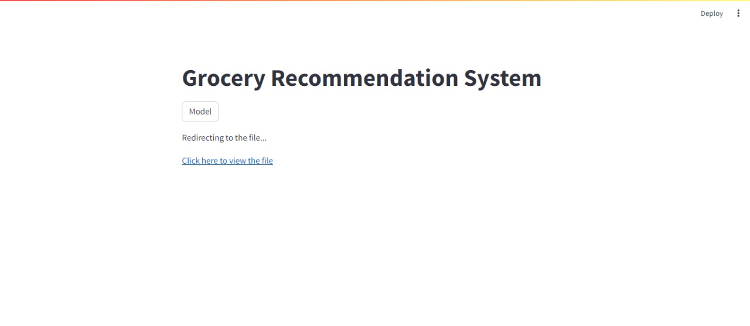
Demonstrate working of the solution to the evaluation team

Slide 12
Important Links:-
GitHub Public Repository Link -
Link to test cases and data files -
Riteshsavale_Scifor/ at main · Ritesh1704/Riteshsavale_Scifor (github.com)
price prediction - Jupyter Notebook
*You can make a copy of the slides. Do not change the template branding.

Slide 13


